Slide 1

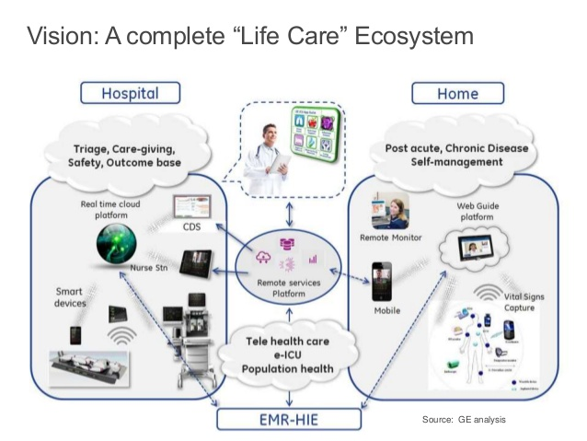
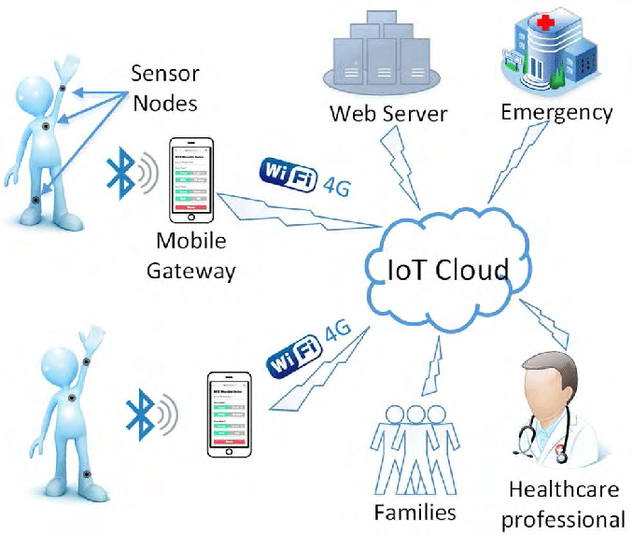
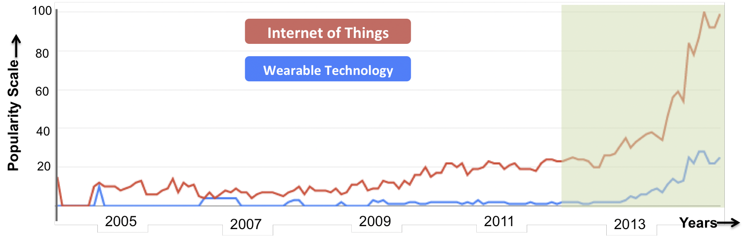
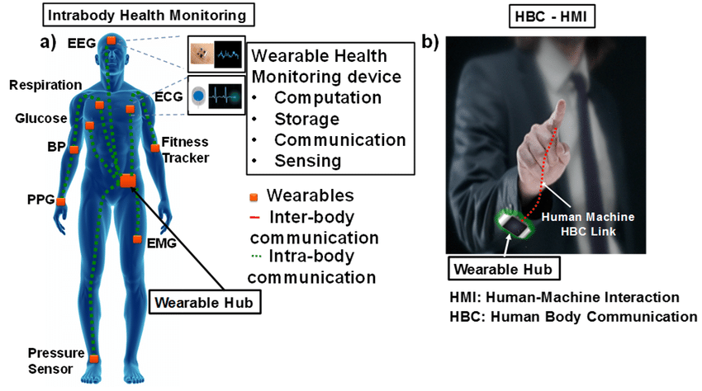
Healthcare IoT Solution Architecture
William Trentham
Austin Peay State University
Abstract
The Internet of Things in the healthcare sector is becoming widely popular. The ability to remotely view a patient’s vitals and other health related data helps the healthcare providers provide better services for the patient and it can also help to keep the cost of healthcare down. These Internet of Things solutions generally have similar architectures. This architecture consists of 3 separate levels; Wearable body sensors, internet connected gateways, and the cloud. These 3 components work seamlessly together to gather data, analyze the data, and share this data with the healthcare professionals.
The wearable body area sensors are worn by the patient which collects health center data. One example is an ekg monitor monitoring heart activity. These sensors do not have much processing power; however, they do not need to perform any taxing data analysis. However, instead they transmit the data gathered to the gateway devices. These gateway devices are generally smart phones, tablets, or laptops. These devices are essential because of the mobility of the devices. These gateways are responsible for storing some of this data and performs some data analyses, but the main function is transmitting the data to the cloud. The cloud is where all the data is stored and then actions like data mining and machine learning are performed on the data in order to get useful information from this data. This information determined by the cloud computing is sent to the healthcare professionals where they can analyze it and provide the patient with the appropriate treatment. All of these components are essential to the success of the Internet of Things architecture. Using this architecture in an Internet of Things solution can help revolutionize the Healthcare sector for all parties involved. Different IoT health care architectures will be investigated.
Architecture
Figure 2: Architecture of a “Life Care” Internet of Things solution [Grubis 17].
Internet Connected Gateways and Cloud Support
Figure 3: Internet Connected Gateways and Cloud architecture [Wu 1].
Introduction
Throughout the recent year the cost of healthcare has been growing along with the increasing demand for healthcare services. Many current healthcare services are inconvenient for both the providers and for the patients requiring them to make repeated trips to the doctor’s office or Emergency Room just to have a few tests performed that could easily be performed remotely. With increasing advancements in technology these things are possible by incorporating Internet of Things solutions into the healthcare sector. These solutions can allow for remote monitoring of a patient’s vitals along with many other health related data. The architecture for these solutions are separated into three components; Wearable Body Sensors, Internet Connected Gateways, and Cloud support.
Figure 1: Google search (since 2004) for the terms –– "Wearable Technology" and "Internet of Things". (Source: Google Trends, Google Inc.) [Hiremath 2]
Internet Connected Gateways and Cloud Support
Internet Connected Gateways are portable devices such as smartphones, tablets, and laptops that are relayed data from the body sensors using ”short-range communication technology such as Bluetooth” [Hiremath 4-5]. The gateways are used for less taxing processing and data analysis. The gateway is primarily used for transmitting the data to and from the cloud. The cloud is used to “facilitate the management of wearable data and can support advanced functionalities of data mining, machine learning, and medical big data analytics” [Hiremath 5]. These processes are performed to organize the data and remove any useless data. The cloud is also able to create a “Data visualization that can channelize the data to end-users such as physicians and patients to provide decision support and patient-physician interactions” [Hiremath 5]. Using all of this architecture, the IoT healthcare solution is able to allow healthcare providers monitor and prescribe the correct treatment for patients at a more convenient and cheaper rate.
Wearable Body Sensors
Wearable Body Sensors are sensors worn by patients to collect health centered data. The sensors collect a wide range of data from pulse to glucose levels. The primary function of the sensors is to collect data and are equipped with minimum storage and processing capabilities. Due to the hardware restrictions the sensors rely primarily on offloading data to the Internet Connected gateways for further processing. Hiremath states that these sensors should be reliable and require little maintenance; “WBAS are required to meet global quality standards to ensure their long- term operation with minimum supervision and management” [Hiremath 4].
Figure 3: Wearable Body Sensors data collection examples [Maity 1]
References
Grubis, Matt. "The Inside Story: GE Healthcare's Industrial Internet Of Things (Iot) Architecture". 2015.
Hiremath, Shivayogi, et al. “Wearable Internet of Things: Concept, Architectural Components and Promises for Person-
Centered Healthcare.” Proceedings of the 4th International Conference on Wireless Mobile Communication and
Healthcare - "Transforming Healthcare through Innovations in Mobile and Wireless Technologies", 2014,
doi:10.4108/icst.mobihealth.2014.257440.
Maity, Shovan & Das, Debayan & Sen, Shreyas. (2017). Wearable Health Monitoring Using Capacitive Voltage-Mode
Human Body Communication.
Wu, Taiyang & Wu, Fan & Redoute, Jean-Michel & Yuce, Mehmet. (2017). An Autonomous Wireless Body Area Network
Implementation Towards IoT Connected Healthcare Applications. IEEE Access. PP. 1-1.
10.1109/ACCESS.2017.2716344.

